Slide 1
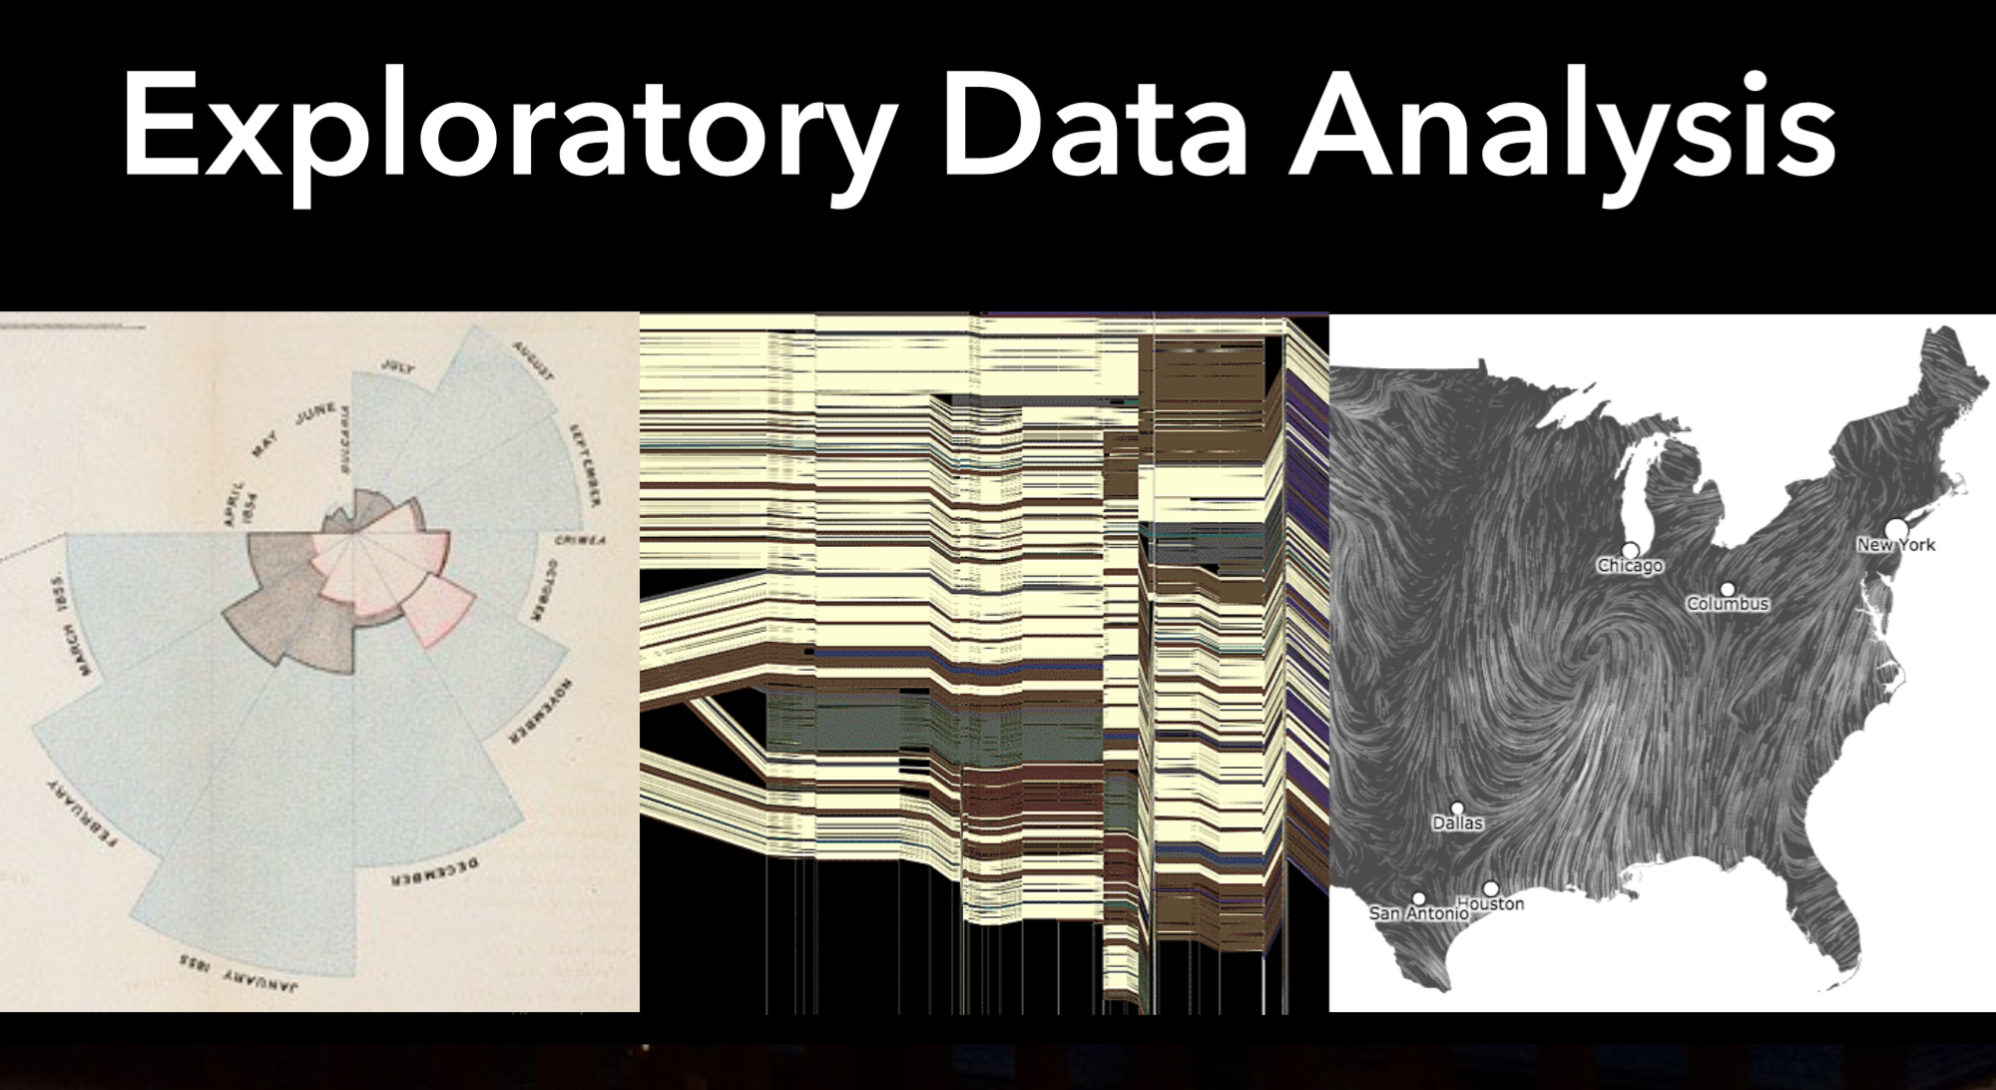

Slide 3
Notes:
A wall painting radio carbon dated to approximately 6200 BCE, found in 1963 at this site by archaeologist James Mellaart, may be the earliest landscape painting known, or it may be a map.
"It appears to represent the town itself with eighty rectangular buildings of varying sizes clustered in a terraced town landscape. Mellaart noted the similarity of the representation of the houses to the actual excavated structures found at the site, that is, rows of houses built one beside the other with no space between them. The wall painting shows an active double-peaked volcano rising over the town, likely to be the 3,200 m stratovolcano Mount Hasan, which is visible from Catal Huyuk. Lava is depicted flowing down its slopes and exploding in the air above the town. A cloud of ash and smoke completes the scene" (Rochberg, "The Expression of Terrestrial and Celestial Order in Ancient Mesopotamia," IN: Talbert (ed) Ancient Perspectives: Maps and Their Place in Mesopotamia, Egypt, Greece & Rome [2012] 10-11).

Slide 4
Notes:
The first proto-line chart appeared somewhere in the 10th or 11th century in the appendix of a manuscript called De cursu per zodiacum (The Course of the Zodiac). Here, an unknown author plotted the planetary movements, depicted as cyclic lines on a spatial-temporal grid. (This was centuries before Copernicus and Galileo suggested the Earth rotated around the Sun.)
In this earliest of charts, we see time plotted against celestial latitude for the “classical planets” of Venus, Mercury, Saturn, Mars, Jupiter, the Sun, and the Moon:
The original line chart inventor remains a mystery, but by 1767 Swiss mathematician, physicist, philosopher, and astronomer Johann Heinrich Lambertwas used them regularly in his work. (He’s best remembered for proving that π was an irrational number.) Here, he graphs the evaporation of water vs. time:

Slide 5
Notes:
Early in this century, Christopher Scheiner (1630, recordings from 1611) introduced an idea Tufte (1983) would later call the principle of “small multiples” to show the changing configurations of sunspots over time, shown in Figure 3. The multiple images depict the recordings of sunpots from 23 October 1611 until 19 December of that year. The large key in the upper left identifies seven groups of sunspots by the letters A–F. These groups are similarly identified in the 37 smaller images, arrayed left-to-right and top-to-bottom below.

Slide 6
Notes:
Among his contributions were attempts to determine longitude.^{[1]} To show the magnitude of the problem, he created the first (known) graph of statistical data, showing the wide range of estimates of the distance in longitude between Toledo and Rome. He believed he could improve the accuracy of longitude determination, particularly at sea, by observing peaks and craters of the Moon as they appear and disappear, not only during eclipses of the Moon but also in the course of the entire lunation. This led him to make a map of the Moon (published in 1645), and he planned to produce maps of the Moon at thirty different phases, but never realized this plan. He was the first to assign names to various lunar features, but few of these names were widely accepted because they mostly corresponded to Catholic monarchs, scientists and artists.^{[2]}

Slide 7
Notes:
The original line chart inventor remains a mystery, but by 1767 Swiss mathematician, physicist, philosopher, and astronomer Johann Heinrich Lambert used them regularly in his work. (He’s best remembered for proving that π was an irrational number.) Here, he graphs the evaporation of water vs. time:

Slide 9
Notes:
TUFTE states:
Data graphics should draw the veiwers attention to the sense and substance of the data, not to something else. The data graphical form should present the quantitative contents. Occasionally artfulness of the design makes the graphic worthy of the Museum of Modern Art, but essentially the statistical graphics are instruments to help people reason about quantitative information.
Playfair’s very first charts devoted too much of their ink to graphical apparatus, with elaborate grid lines and detailed labels.
But this time series graph eliminated much of the non-data detail in favor of a cleaner design that focused attention on the time series itself. – a clear and elegant display!

Slide 10
Notes:
Pie chart from Playfair's Statistical Breviary (1801), showing the proportions of the Turkish Empire located in Asia, Europe and Africa before 1789
A scientific revolution began at the end of the 18th century with the creation and popularization of the graphic display of data by Scottish inventor William Playfair, who introduced the line graph, bar chart, and pie chart into statistics. His remarkable Atlas demonstrated how much could be learned if one plotted data graphically and looked for suggestive patterns to provide evidence for pursuing research. In the Statistical Breviary, Playfair invented the pie chart and expanded upon this concept to facilitate the comparison of the resources of European countries.

Slide 11
Notes:
He was a mathematician!

Slide 12
Notes:
Florence Nightingale was amazing!

Slide 14
Notes:
Minard also included an interesting chart in the upper right-hand corner of the map, showing the amount of British coal produced for each year between 1850 and 1864, and how it was used. Click here or on the picture below to see a close-up of the chart. The graph shows the tremendous changes in coal production over only a decade and a half–an increase of nearly 100% from just over 50 million to nearly 95 million tons. Of this, less than 10% was ever exported–meaning that the British domestic market was consuming nine times as much coal as is shown as exported in the main map.
The major uses of British coal, according to the chart, are: the production of iron (“Fer”) and cast iron (“Fonte”), gas lighting (“Eclairage au gas”), steam engines in ships and trains (“Navires a Vapeur et Chemins de Fer”), and domestic fireplaces (“Foyers Domestiques”). A large amount of this production was also specifically slated for use in London, showing how that city was the major center of British industry.

Slide 15
Notes:
This cartogram uses one large mosaic (in the lower left) to show the numbers of passengers and tons of freight shipped from Paris from the four principal train stations. Of the total leaving Paris, the amounts going to each main city are shown by smaller mosaics, colored according to railway lines; of those amounts, the distribution to smaller cities is similarly shown, connected by lines along the rail routes.

Slide 16
Notes:
Looks like they are leaving New York and going to Kansas!
There is very little difference between immigrant and emigrant semantically; both words refer to a person who leaves one country in order to move to another (generally for a permanent or significant stay). The main difference is that immigrant is used in reference to the country moved to, and emigrant is used in reference to the country moved from. There are several ways of remembering how to distinguish between these words: people are emigrants when they leave their country of origin, and immigrants when they arrive at their destination, or an emigrant is given an additional Mwhen moving to a new country.

Slide 27


Slide 30
Notes:
Data!

Slide 32
Notes:
Ugly!

Slide 44




